Slide 1
Stolen Diamonds in Banks
Raúl Lizardo

Slide 2
Insights:
The stolen diamonds have a total value of $ 212.1 that represents a total weight of 43.0 K carats.
Diamonds with clarities grades S and VS represent the 84.0% ($ 178.2M) of the total solen value ($ 212.1M).
The best-cut diamonds that have been stolen are the smallest ones.
85.95% of the stolen diamonds (53.9 K) were robbed from USA

Slide 3
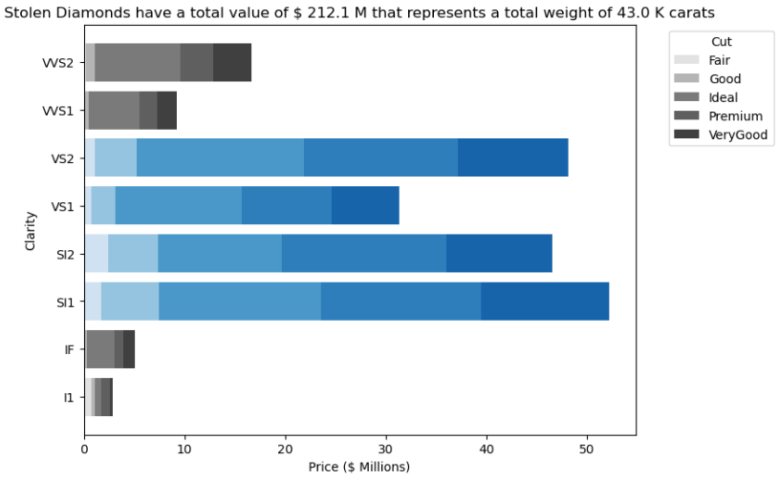
Clarity Grades
Diamonds with clarities grades S, VS and VVS represent the 84.0% ($ 178.2M) of the total solen value($ 212.1M)

Slide 4
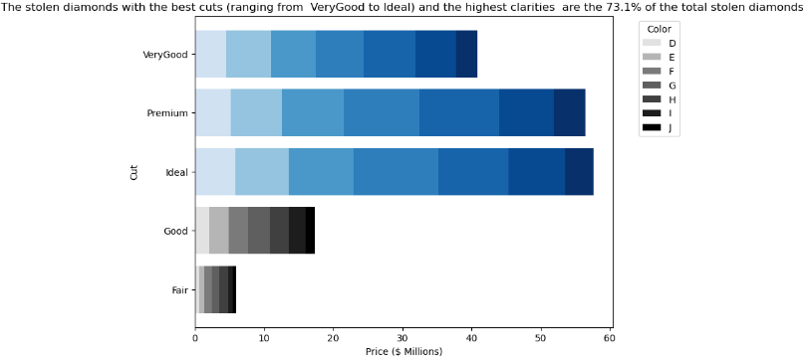
Cut Grades
The distribution of the Colors are similar between the Cut Grades.

Slide 5
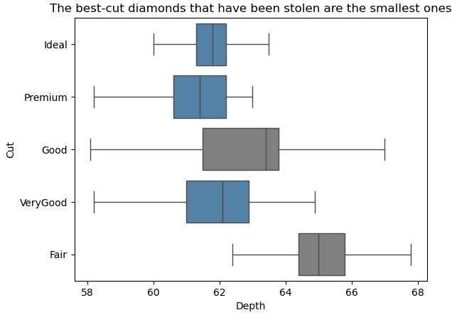
Depth Distribution
The best diamonds are considered with the highest clarity and cut grades. These ones are 2.7% smaller than the worst diamonds, which have a median (63.5) .

Slide 6
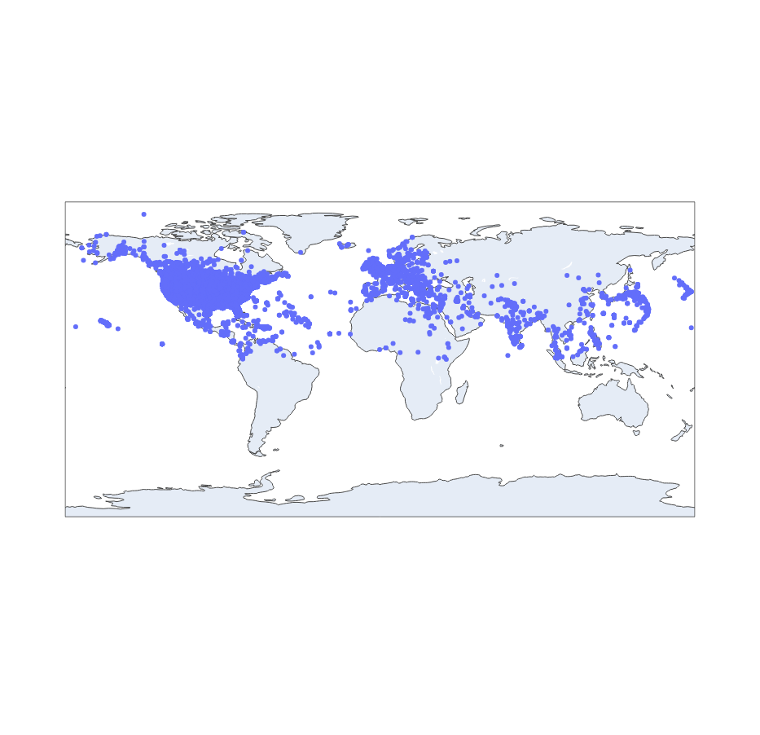
Stolen Diamonds distribute in the World.
85.95%
85.95% of the stolen diamonds (53.9 K) were robbed from USA (46.4 K).

Slide 7
Focus Efforts
Urgencelly improve the security in the banks at USA.
85.95%
Increase the vigilance on the diamonds with clarity grades SI and VS, and cut grades Very Good, Premium and Ideal because they represent 73.1% of the total stolen value.

